Slide 1
River dart investigation

Slide 2
Does the velocity, width, depth and discharge decrease as the river moves downstream?
Question

Slide 3
Successfully measure the velocity, width, depth, and discharge of the River Dart in 3 different places, Newbridge Car Park, the River Dart Country Park, and Dartmeet
Objective of the study

Slide 4
Data collection methods
velocity meter
measuring tape
metre sticks

Slide 5
Health and Safety
welly boots
DO NOT cut anyone.

Slide 6
Choosing a location
Private land
Fences
Not too deep
Not too fast

Slide 7
Locations chosen
Dartmeet
Newbridge car park
River dart country park

Slide 8
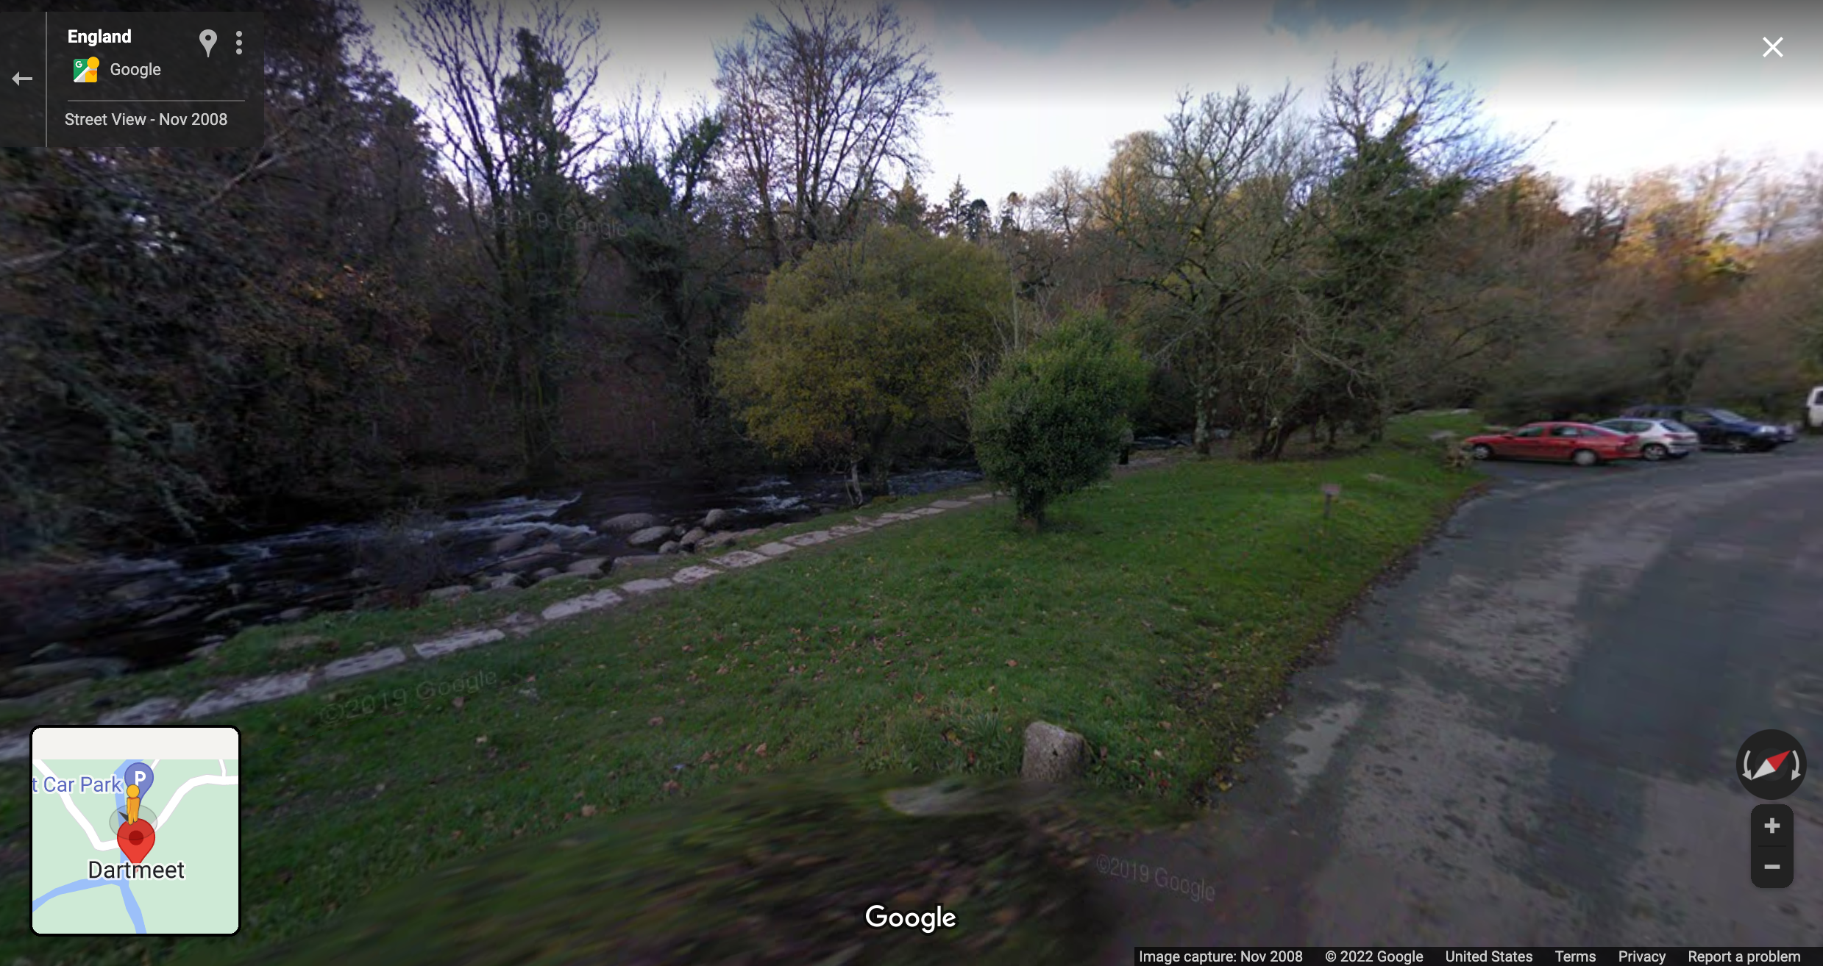
Dartmeet

Slide 9
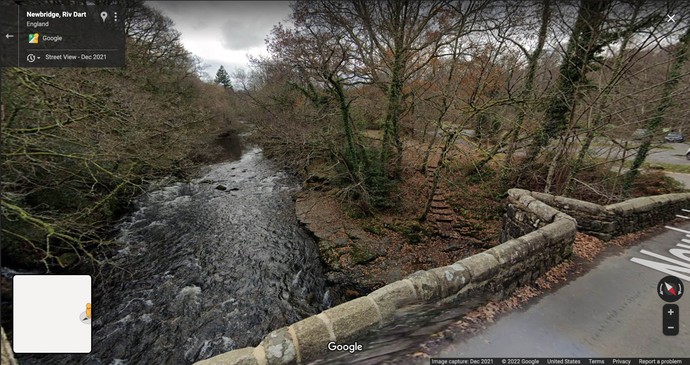
Newbridge Carpark

Slide 10
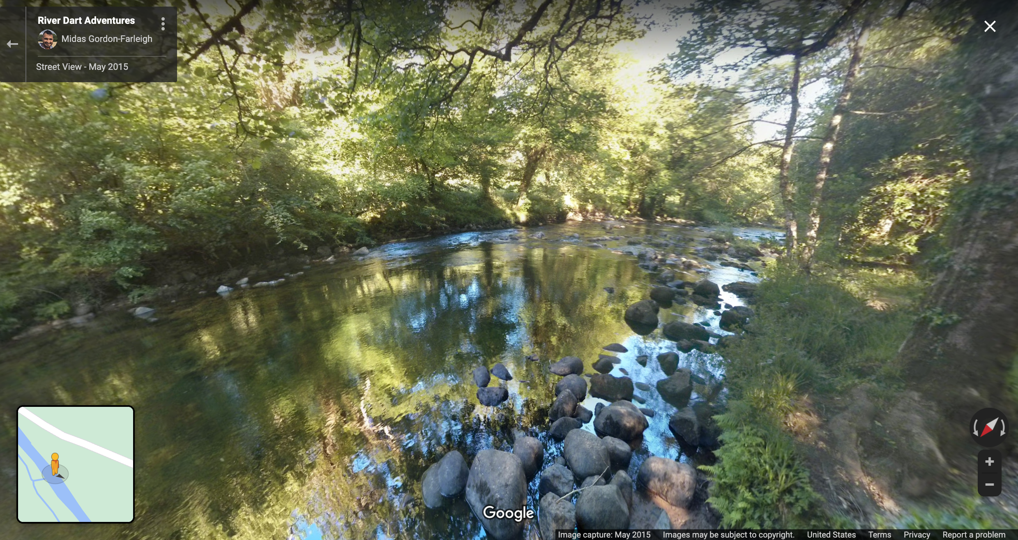
River Dart Country park

Slide 11
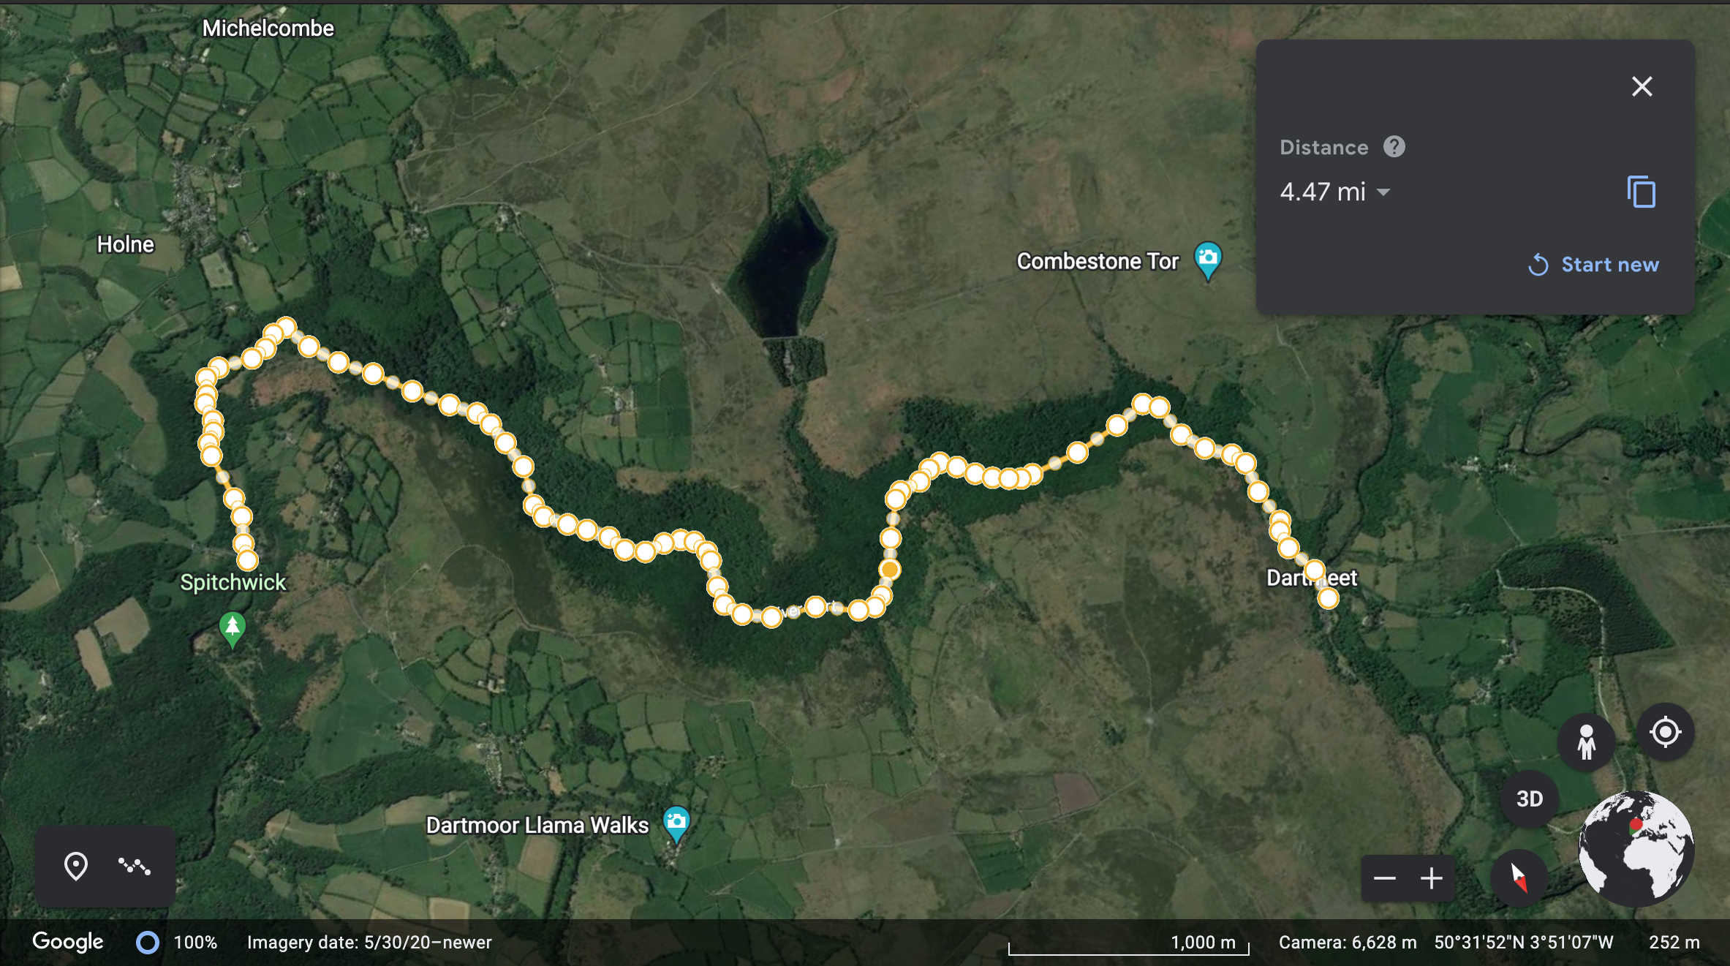
Distance from Dartmeet to newbridge car park

Slide 12
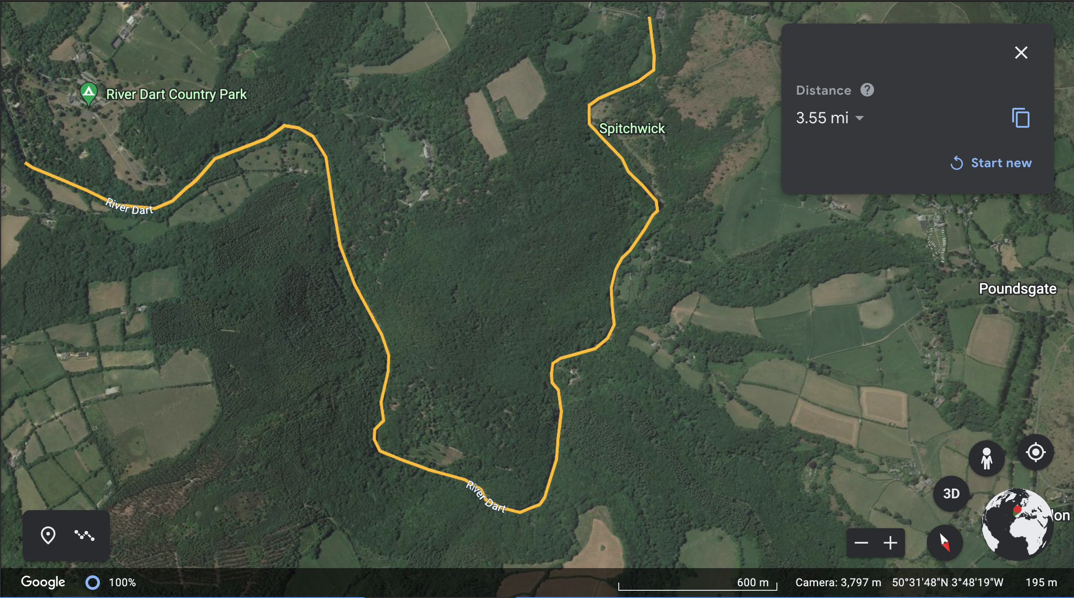
Distance from newbridge car park to river dart country park

Slide 13
Data
Site | Width | Depth | Velocity | Discharge
Dartmeet | 12M | 0.3M | 1.5M/S | 5.4 cumecs
Newbridge Car Park | 16M | 0.4M | 2M/S | 15.36 cumecs
River Dart Country Park | 20M | 0.5M | 3M/S | 30 cumecs

Slide 14
Data

Slide 15
Analysis of data
Increase
erosion on the banks

